Slide 1
DuraMAT New Project 3-Slide Template
Please complete for your new project. These slides should be incorporated in your future quarterly reporting presentations and updated as needed.

Slide 2
Investigation of Interfacial Degradation in Glass/Glass PV Modules PI: Laura Schelhas - NREL
EXAMPLE
Chemical/mechanical characterization of G/G module interfaces
Develop adhesion measurements for G/G modules
Demonstrate time-resolved EL imaging method
Core Objective: Fielded Module Forensics
Team: SLAC: Archana Sinha, Sona Ulicna
NREL: Laura Spinella, Steve Johnston, Dana B. Sulas-Kern, Michael Owen-Bellini

Slide 3
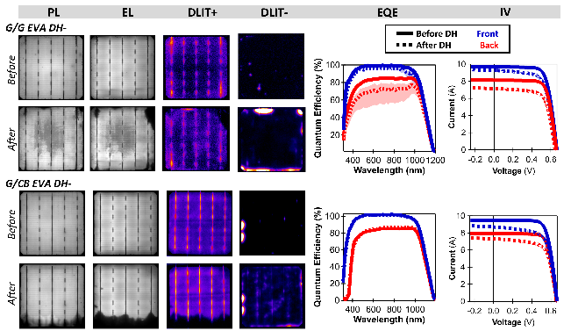
Investigation of Interfacial Degradation in Glass/Glass PV Modules PI: Laura Schelhas - NREL
EXAMPLE
Here we will provide chemical, structural, and mechanical insights that will enable a cutting-edge understanding of the degradation mechanisms present in glass/glass module interfaces
Collect and generate: G/G panels and MiMos which demonstrate degradation
Imaging techniques: assess the full modules and narrow-in on regions where degradation is occurring
Develop: adhesion measurement methods to confirm and quantify the mechanical degradation.
Characterize: degraded regions will be studied in detail using advanced materials forensics methods to monitor degradation at a fundamental level

Slide 4
PI Name
EXAMPLE
Current Proposal Title (Project 2)
Previous Project Title(s) (Project 1)
Goal: Determine the impact of cell cracks on performance/safety + study outdoor aging in state-of-the-art modules. Create predictive models.
Scope of work:
Details
Details
Goal: Determine n-type reliability against UVID and PID at the module level. Define a new standard test-sequence targeting UVID and PID. Explore methods for UVID recovery.
Scope of Work:
Details
Details
Complimentary aspects
Both projects target reliability concerns of modern PV modules, focusing on cracks and outdoor aging (project 1) and indoor accelerated tests UVID and PID (project 2).
Project 1 outdoor aging on control modules may or may not show UV degradation, these results can add additional datapoints to Project 2.
Project 1 modules can be harvested for project 2 root-cause analysis, providing more options for interesting samples.
Module acquisition can be time consuming, if needed, extra unstressed samples from project 1 could be applied to project 2.
Undesirable Overlap
There is no undesirable overlap between these projects.

